Slide 1
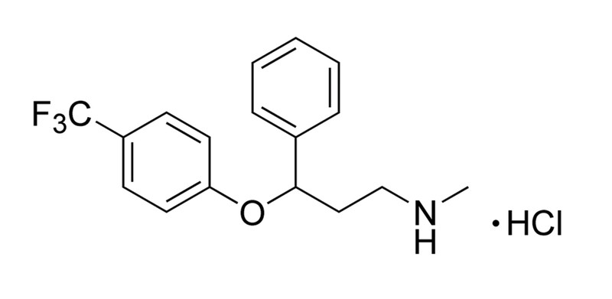
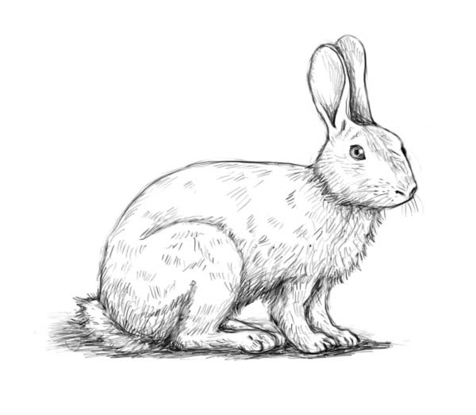
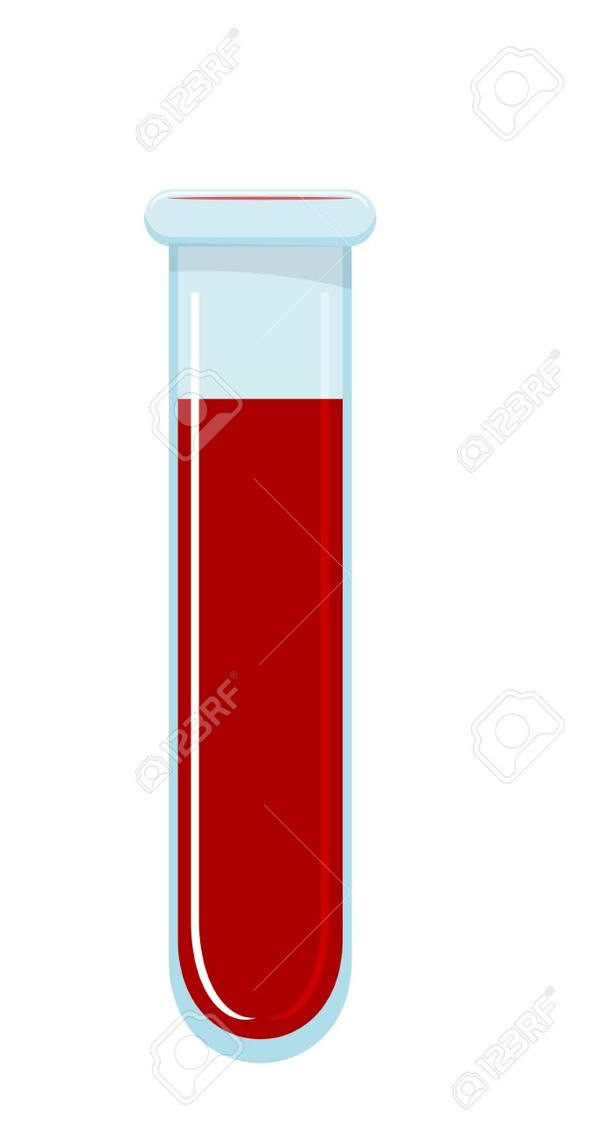
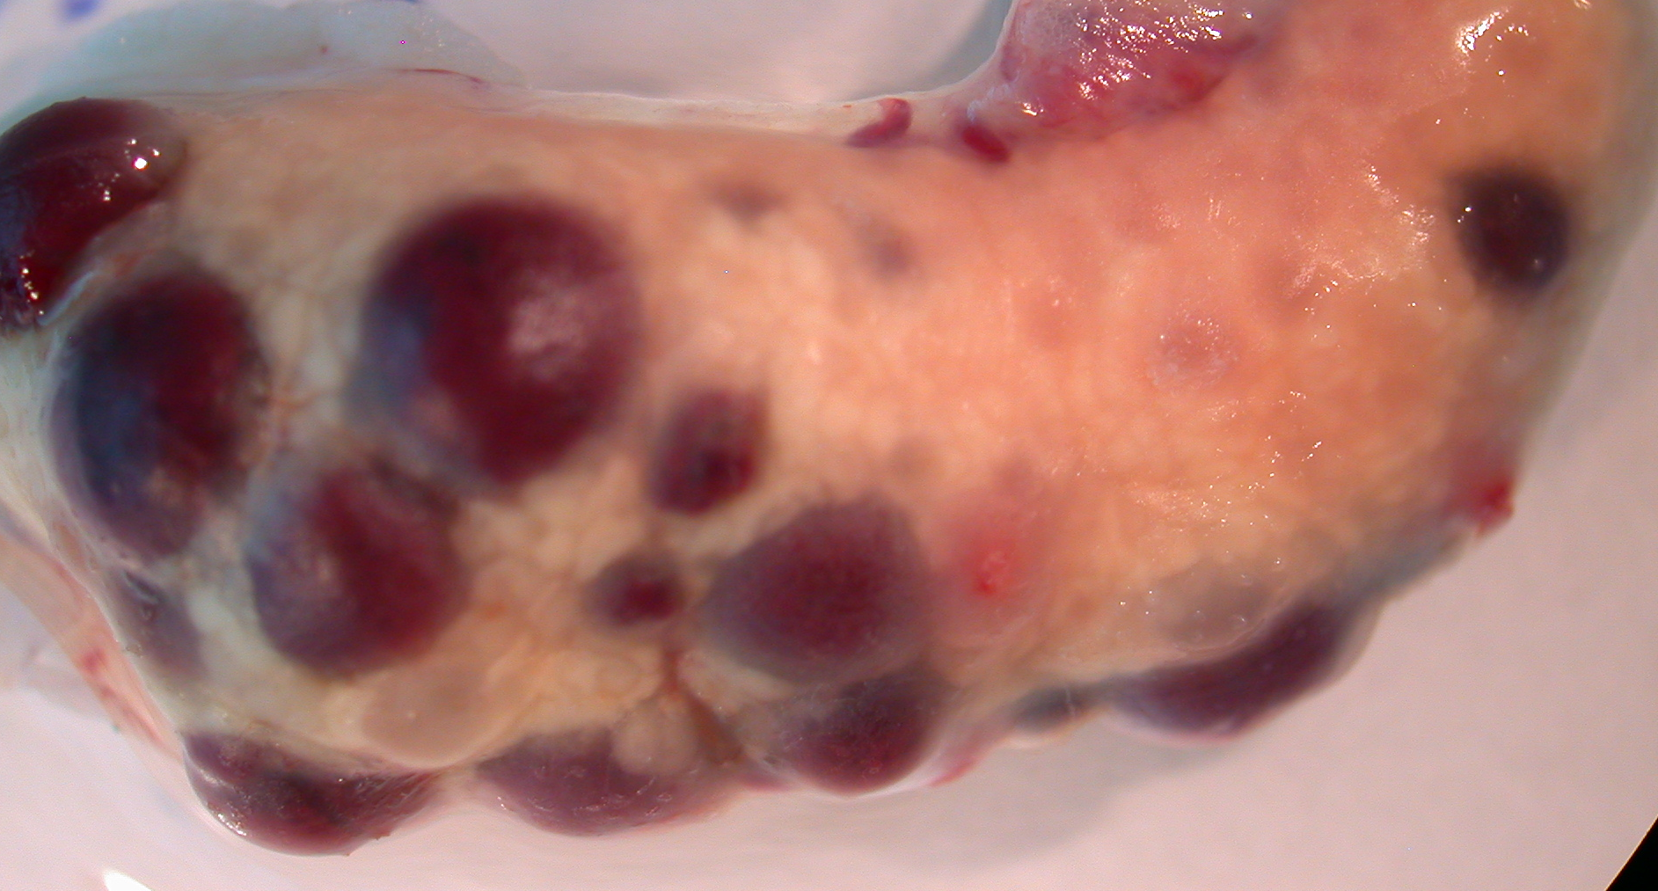
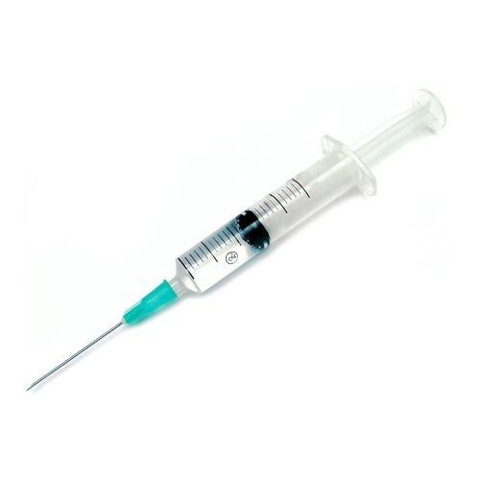
Experiment: testing for peripheral effect of Fluoxetine
2 or 4mg Flx/kg for 14 days
or vehicle control
Fluoxetine, a.k.a. Prozac
hCG
1 day p.i.

Slide 2
N=4
N=5
N=9
N=12

Slide 3
Apparent effect size=10.2%
T-test p=0.11
MWU p=0.14
N=4
N=5
One control animal was lost for trying LH to stimulate ovulation

Slide 4
Comparing control experiments between copulation and hCG
t-test p=0.72
MWU p=0.82
Std hCG=1.09
Std Cop=2.13
F-ratio=3.23
p=0.364, 2-tail
Av=12.25
Av=11.89
hCG
N=4
Copulation
N=9
Control experiments with hCG and copulation induced ovulation are indistinguishable.

Slide 5
Apparent effect size=8.3%
T-test p=0.145
MWU p=0.162
N=13
N=5
The pooled control samples have a larger standard deviation!

Slide 6
T-test p=5.69 x10⁻³
MWU p=4.89x10⁻³
N=13
N=12

Slide 7
N=4
N=5
N=9
N=13

Slide 8
T-test p=1.72*10⁻²
MWU p=4.02*10⁻²
N=9
N=11

Slide 9
Effect size= 12 → 9= -25%
T-test p= 9.48*10⁻³
MWU p= 1.75*10⁻²
N=13
N=11
Eliminating the outlier affects both the average as well as the standard deviation.

Slide 10
Conclusions:
Fluoxetine reduces the number of ovulations induced by copulation by 25 to 30%
The statistical significance is about <10⁻² for t-tests, and 2x10⁻² by Mann-Whithney-U test [non-parametric] depending on data pooling, outlier elimination etc.
Fluoxetine has a small apparent effect of hCG induced ovulations [8 to 10%],
which is not statistically significant (t-test p=0.114; MWU p=0.135), even after pooling control experiments.
The control experiments with copulation- and hCG-induced ovulation are not distinguishable:
Copulation induced average=11.89
hCG induced average=12.25
T-test p=0.72, MWU p=0.82
The variances are apparently different but not significant at F-test p=0.364, 2 tails.

